Slide 1
Vision Diagrams Series Data Lifecycle Management & Records Management
Thierry Matusiak - Information Protection Architect
Version : 2023-05-02

Slide 2
Data Lifecycle Management (DLM) protects
important data during its retention period
It can also erase old data
Records Management extends DLM
to prevent records updates or deletion
Definition

Slide 3
Rules Definition
Rules Application
Context

Slide 4
Manual & Automatic Retention Rules

Slide 5
3 complementary options to apply rules

Slide 6
Labels - Summary

Slide 7
Labels - More Details

Slide 8
Policies - Summary

Slide 9
Policies - More Details

Slide 10
Define Your Governance Strategy
(A) Global Policies
Retention and/or Deletion – Transparent
(A)
(B) Scoped Policies
Retention and/or Deletion – Transparent
(B) + (C)
(C) Automatic Retention Labels
To adapt the scope of your rules and provide visibility to your users
(D)
(D) Manual Retention Labels
To manage special cases and involve your users

Slide 11
Vision Diagrams Series Data Lifecycle Management & Records Management
Thierry Matusiak - Information Protection Architect

Slide 12

EXO Retention

Slide 13

user@entrepriseA.com
Default
Inbox
Mail1
Mail2
UserFolder1
UserFolder2
Mail3
Mail4
UserFolder3
Mail5
Mail6
Archive
Default
Tasks
EXO emailbox structure
Default
Calendar
CalendarEntry1
CalendarEntry2
Default
Deleted Items
Mail7
Mail8
Default
Conversation History
Default
Recoverable Items
Versions
SubstrateHolds
Deletions
Purges
DiscoveryHolds
Online Archive

Slide 14
user@entrepriseA.com
Active Items
Default
Inbox
Mail1
Mail2
UserFolder1
UserFolder2
Mail3
Mail4
UserFolder3
Mail5
Mail6
Archive
Default
Tasks
EXO emailbox structure
Default
Calendar
CalendarEntry1
CalendarEntry2
Default
Deleted Items
Soft deleted Items
Mail7
Mail8
Default
Conversation History
Teams Messages
Default
Recoverable Items
Technical Folders
Versions
SubstrateHolds
Deletions
Hard deleted Items
Purges
Retained Items
DiscoveryHolds
Online Archive
Archive

Slide 15
user@entrepriseA.com
Default
Inbox
Mail1
Mail2
Default
Conversation History
Stores Teams Chats
UserFolder1
UserFolder2
Mail3
Default
Recoverable Items
Mail4
Versions
Versions contains all the versions of emails
(if Litigation Hold or a Purview EXO Retention Policy is enabled)
UserFolder3
SubstrateHolds
SubstrateHolds contains all the versions of Teams Chat Messages
(if Litigation Hold or a Purview Teams Chat Messages Retention is enabled)
Mail5
Deletions
Mail6
Deletions : stores soft-deleted messages
Purges
Purges : keeps deleted data for Litigation Hold
Archive
DiscoveryHolds
DiscoveryHolds : keeps deleted data for Purview Policies
Default
Tasks
EXO emailbox structure
Note : the Calendar default folder is hidden
Default
Calendar
CalendarEntry1
CalendarEntry2
Default
Deleted Items
Mail7
Mail8
Default
Conversation History
Default
Recoverable Items
Versions
SubstrateHolds
Deletions
Recoverable Items
https://docs.microsoft.com/en-us/exchange/security-and-compliance/recoverable-items-folder/recoverable-items-folder
Purges
Default
DiscoveryHolds
Online Archive
Default
EXO Default folders
https://docs.microsoft.com/en-us/Exchange/default-folders-exchange-2013-help

Slide 16
1
Note : users cannot apply
a Retention label on a whole mailbox
Purview Retention : Policies & Labels
user@entrepriseA.com
No Archiving Rules
Default
Inbox
RETENTION
& DELETION
Retention Policy
Mail1
Not supported
Mail2
Default
UserFolder1
1
2
Retention Label
UserFolder2
1
Mail3
Mail4
2
UserFolder3
Mail5
Mail6
Archive
Default
Tasks
EXO - Purview retention (& deletion)
Default
Calendar
CalendarEntry1
CalendarEntry2
Not
supported
Default
Deleted Items
Mail7
Mail8
Default
Conversation History
Default
Recoverable Items
Versions
SubstrateHolds
Deletions
Purges
DiscoveryHolds
Online Archive

Slide 17
L
D
Note : users cannot see nor supercede DPTs
EXO Retention : MRM Policy
user@entrepriseA.com
A
Default
Inbox
Note : users cannot see that a litigation hold is applied on their mailbox
DELETION
ONLY
A
Default Policy Tag (DPT)
Mail1
D
Mail2
1
Default
Retention Policy Tag (RPT)
UserFolder1
1
2
Personal Tag
UserFolder2
1
Mail3
Mail4
EXO Preservation : Litigation Holds
2
UserFolder3
RETENTION
ONLY
Litigation Hold
Mail5
L
Mail6
Default
Not supported
Archive
Not supported
Default
Tasks
EXO - native deletion & retention
Default
Calendar
Note : users cannot apply Personal Tags
on Calendar Entries
CalendarEntry1
CalendarEntry2
Default
Deleted Items
1
Note : users cannot see nor supercede RPTs
Mail7
Mail8
Default
Conversation History
Default
Recoverable Items
Versions
SubstrateHolds
Deletions
Purges
DiscoveryHolds
Online Archive

Slide 18
user@entrepriseA.com
Default
Inbox
Mail1
Mail2
UserFolder1
UserFolder2
Mail3
Mail4
UserFolder3
user action
to recover items
Mail5
Mail6
user
deletion
action
Archive
MRM Tag expiration
or Purview Deletion
Default
Tasks
EXO email lifecycle
Default
Calendar
CalendarEntry1
CalendarEntry2
Default
Deleted Items
Mail7
Mail8
Default
Conversation History
14
days
Default
Recoverable Items
Versions
SubstrateHolds
Deletions
Purges
Litigation
Hold
Purview
Retention
DiscoveryHolds
Online Archive
Permanent Deletion when litigation hold
or Purview Retention period expires

Slide 19
Conclusion

Slide 20
Appendices

Slide 21
Practical Example
Tenant/MySiteName
Document Library
FolderA
FolderB
Sharepoint site
Pres.pptx
Docu.docx

Slide 22
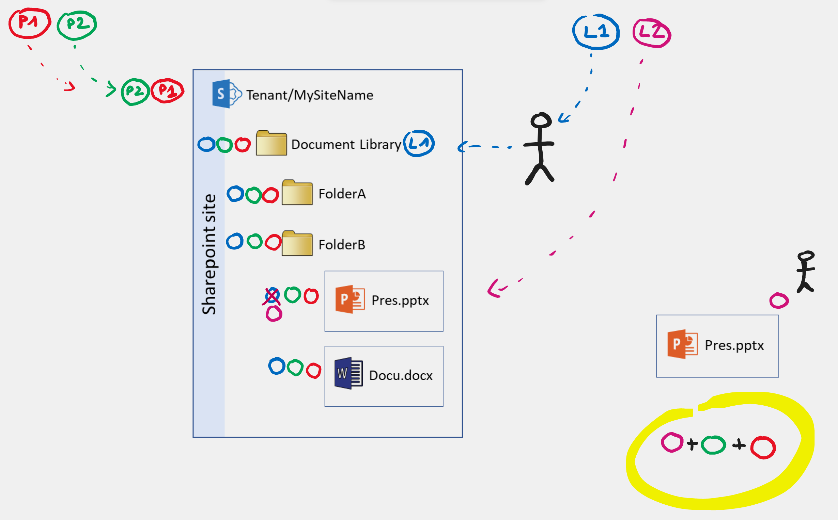
Practical Example

Slide 23
Retention Rules + Deletion Rules
Identify your current rules
Business + IT + Privacy perspectives
Automatic ? Manual ?
To be kept ? To be replaced ?
List your target rules and their goals
Ensure compliance
Control data volumes
Contribute to business processes
Know about the rules supported in the MSFT solution
Set of coherent practices
Evolution Roadmap
Data Lifecycle – Project

Slide 24
Teams Data : Where Is It Stored ?

